Slide 1
Transmission
Control
Protocol
(TCP)

Slide 2


Slide 3
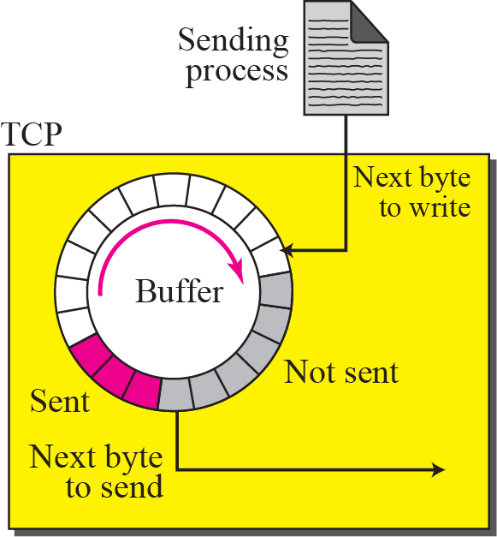
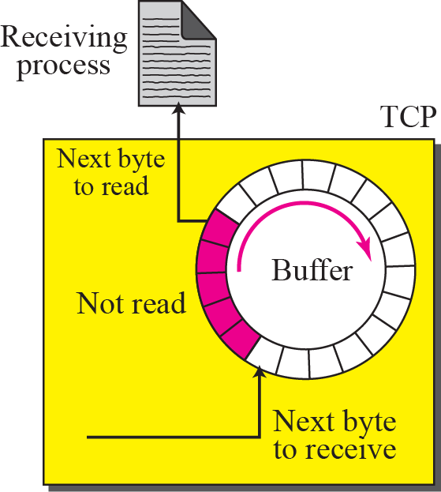
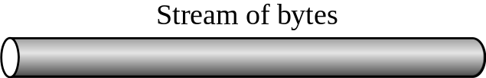
Sending and receiving buffers

Slide 4
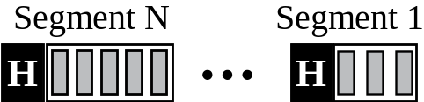
TCP segments
Numbering:
Byte Number
Sequence Number
Data + Ctrl, Data, Ctrl (response) - Valid Sequence number
Acknowledge Number

Slide 5

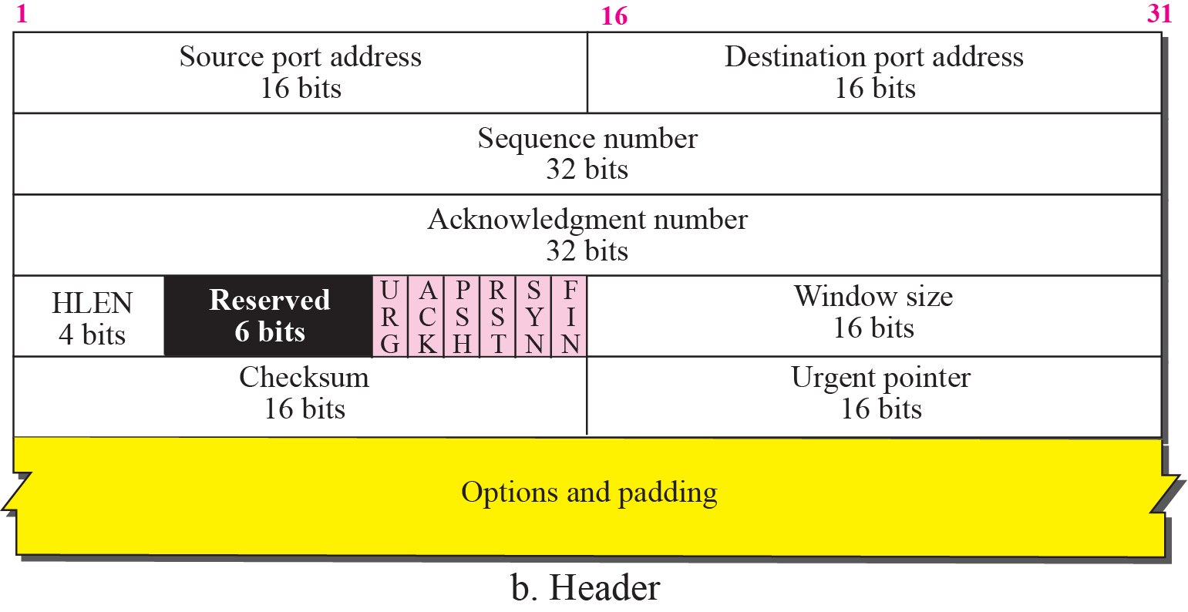
TCP segment format

Slide 6

Control field

Slide 7
TCP Connections
Connection Establishment
Data Transfer
Connection Termination
Connection Reset

Slide 8
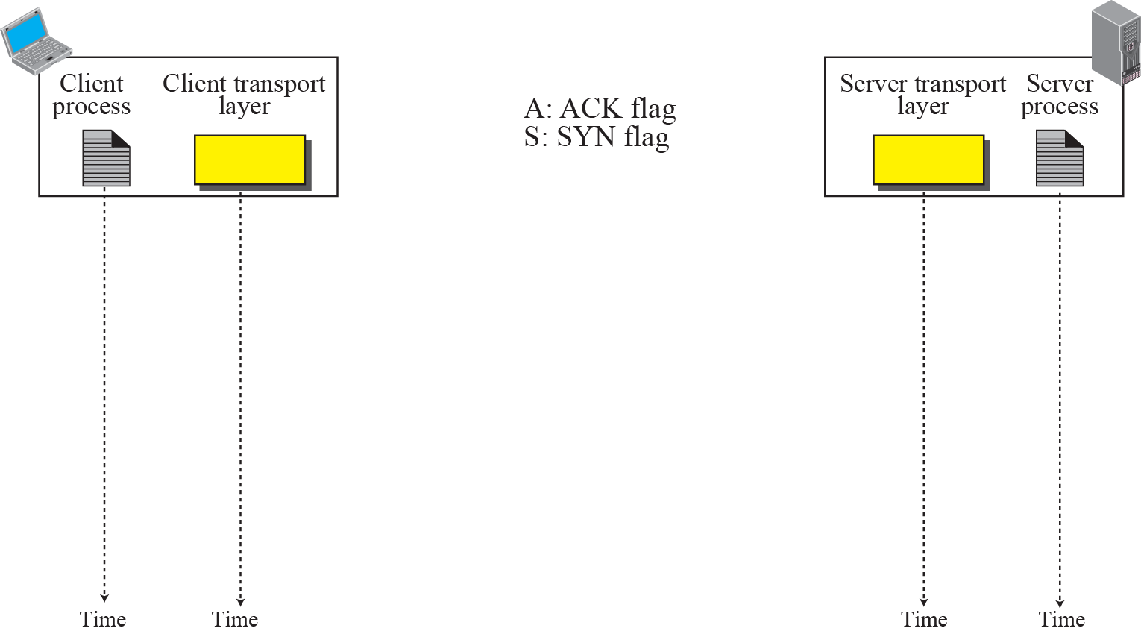

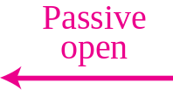
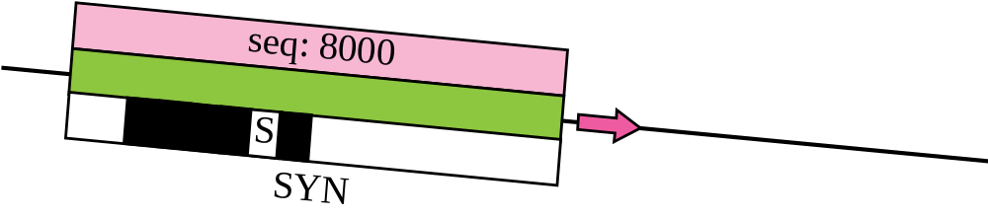
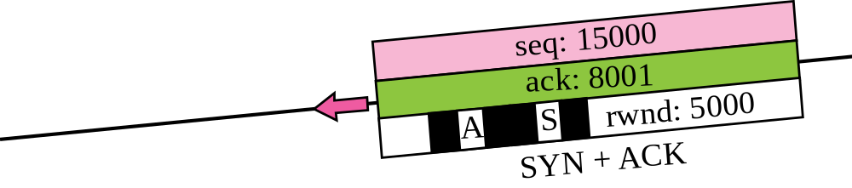
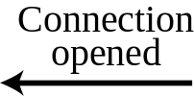
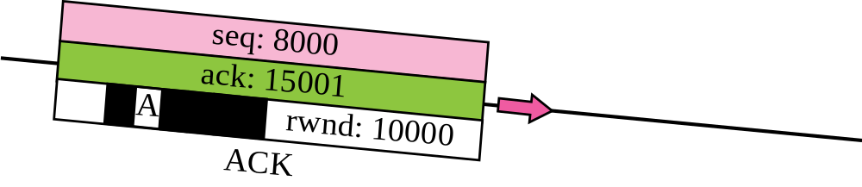

Connection establishment using three-way handshake
Means “no data” !
seq: 8001 if piggybacking

Slide 9
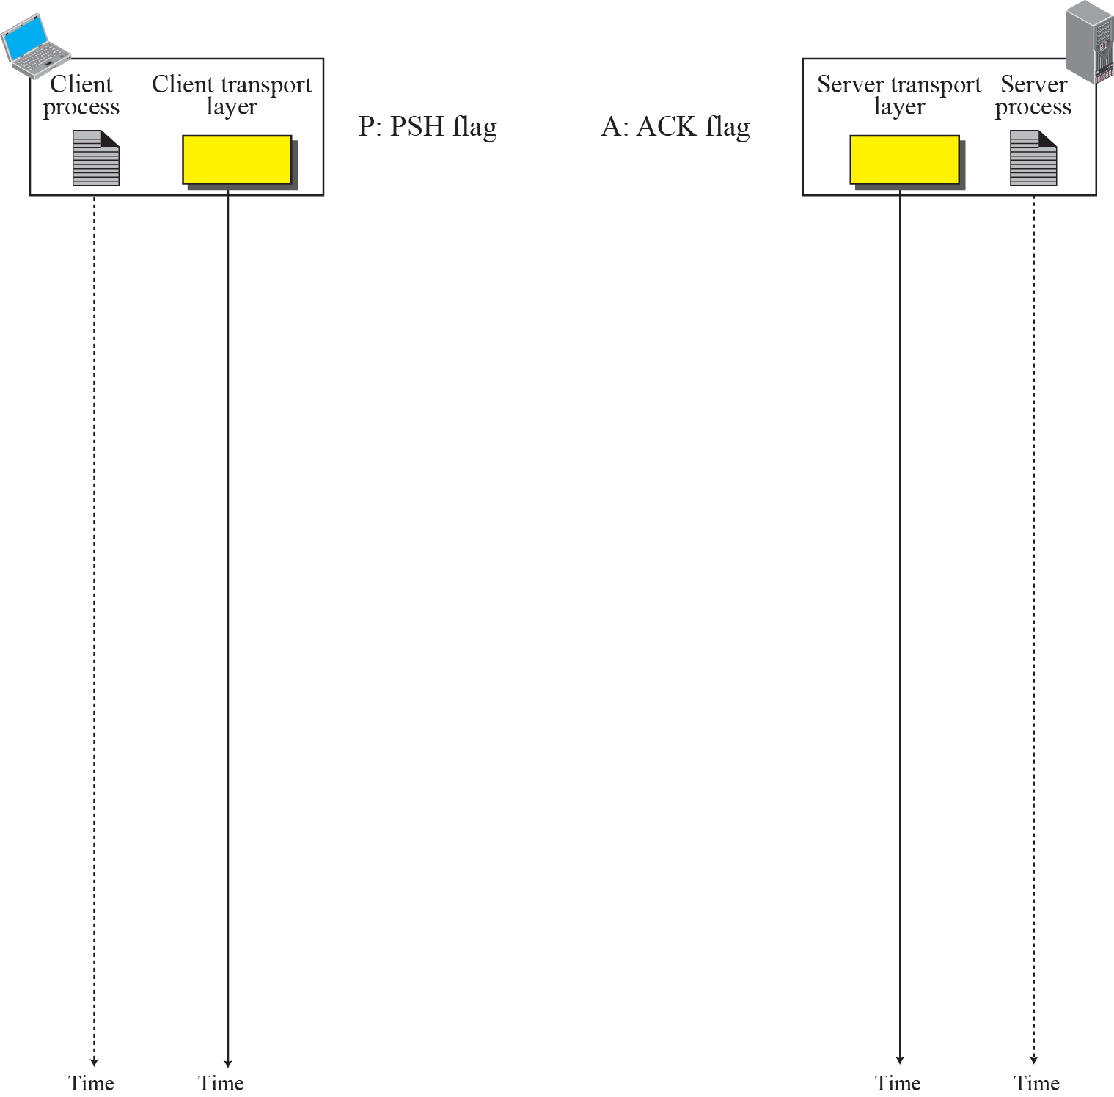
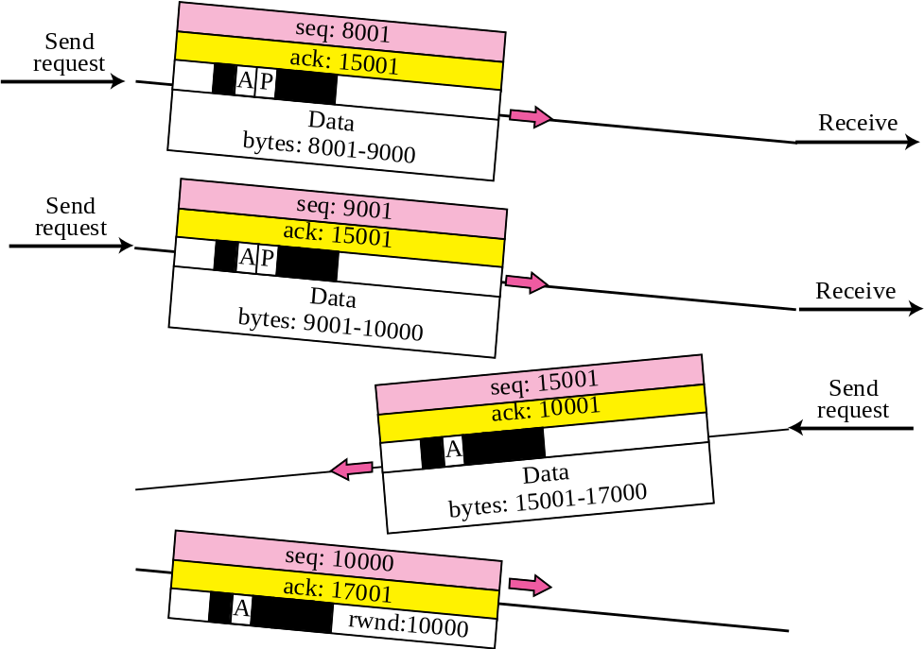

Data Transfer
Pushing data
Urgent data

Slide 10
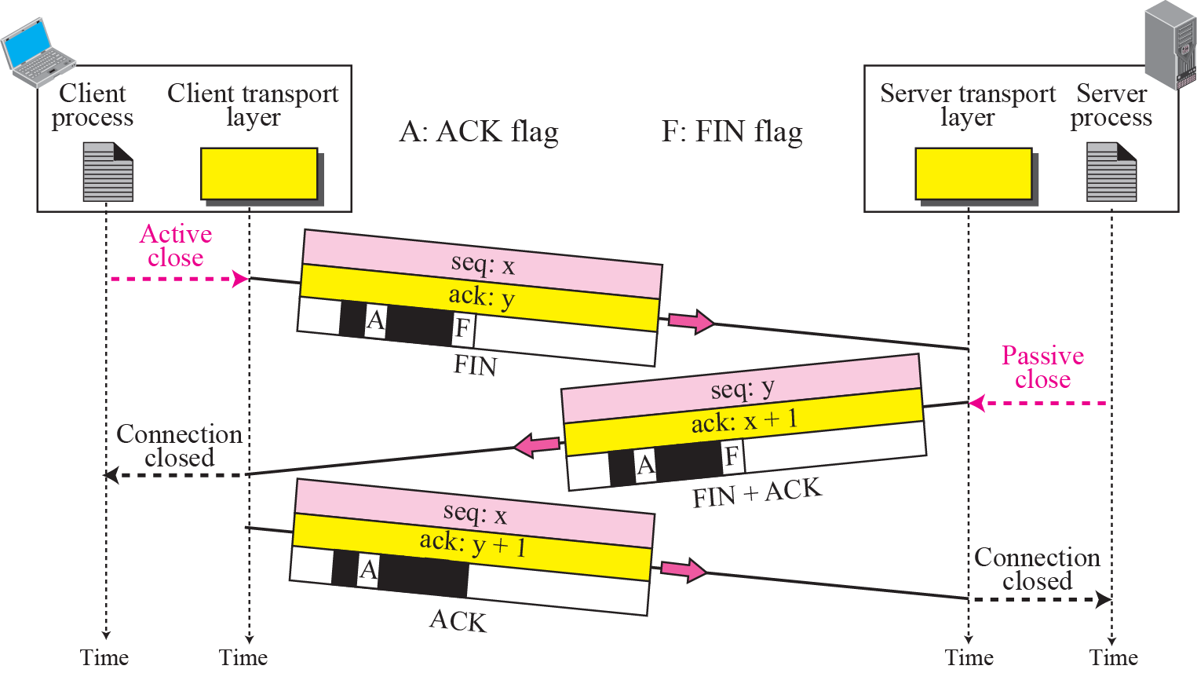
Connection termination using three-way handshake

Slide 11
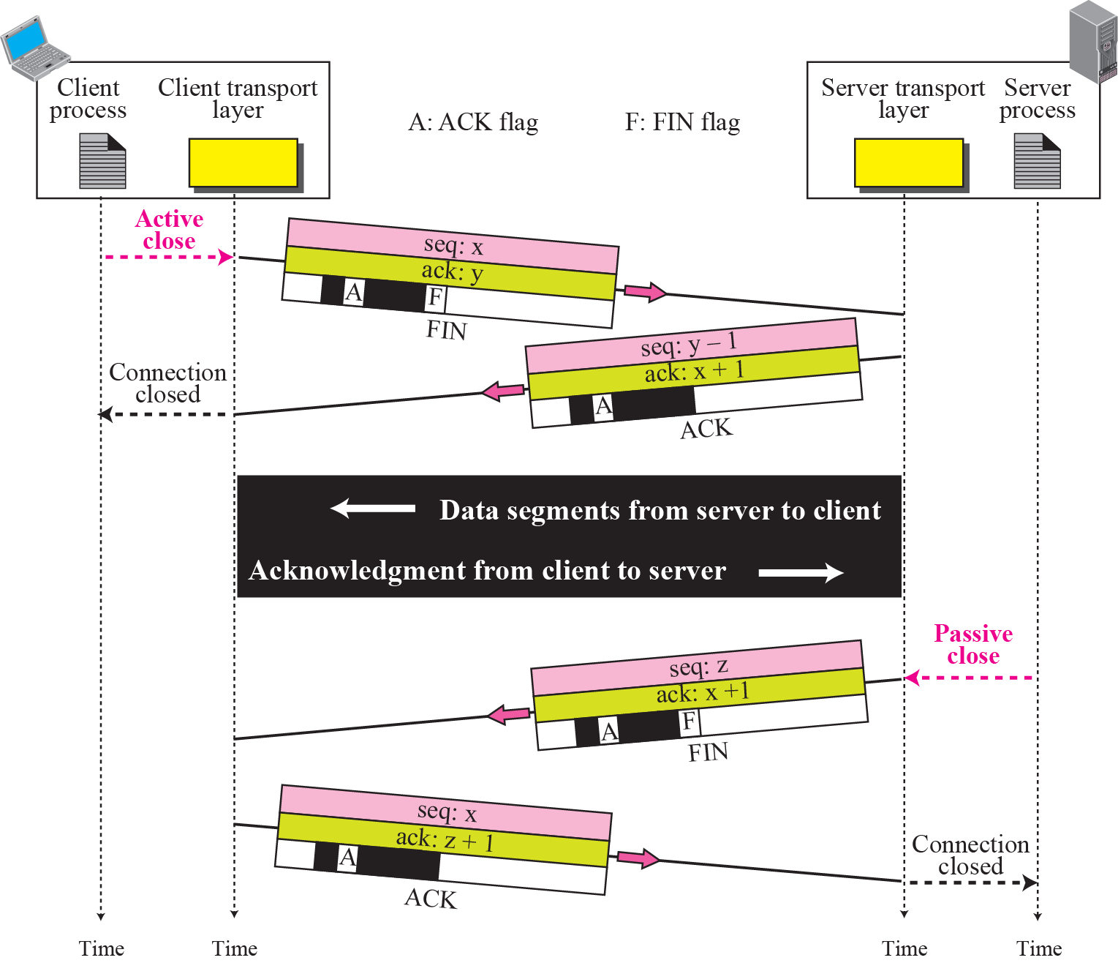
Half-Close

Slide 12
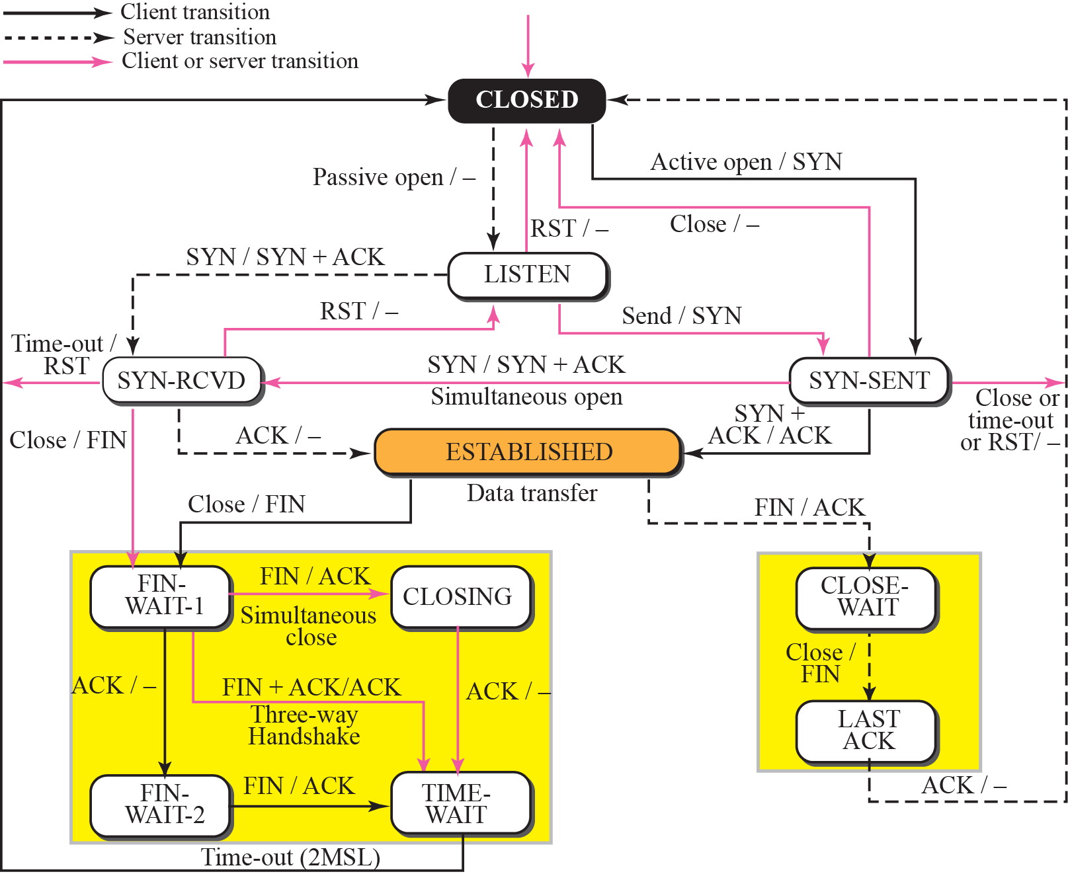
STATE TRANSITION DIAGRAM

Slide 13
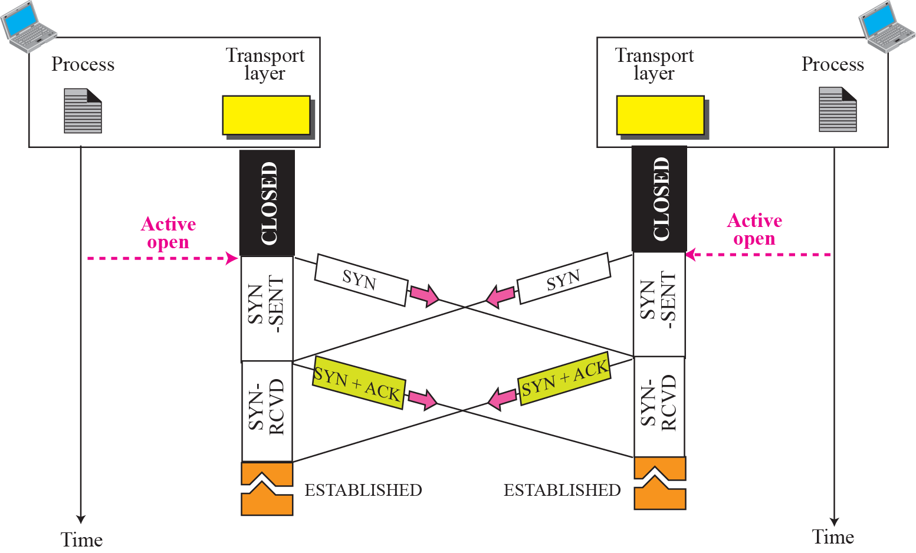
Simultaneous open

Slide 14
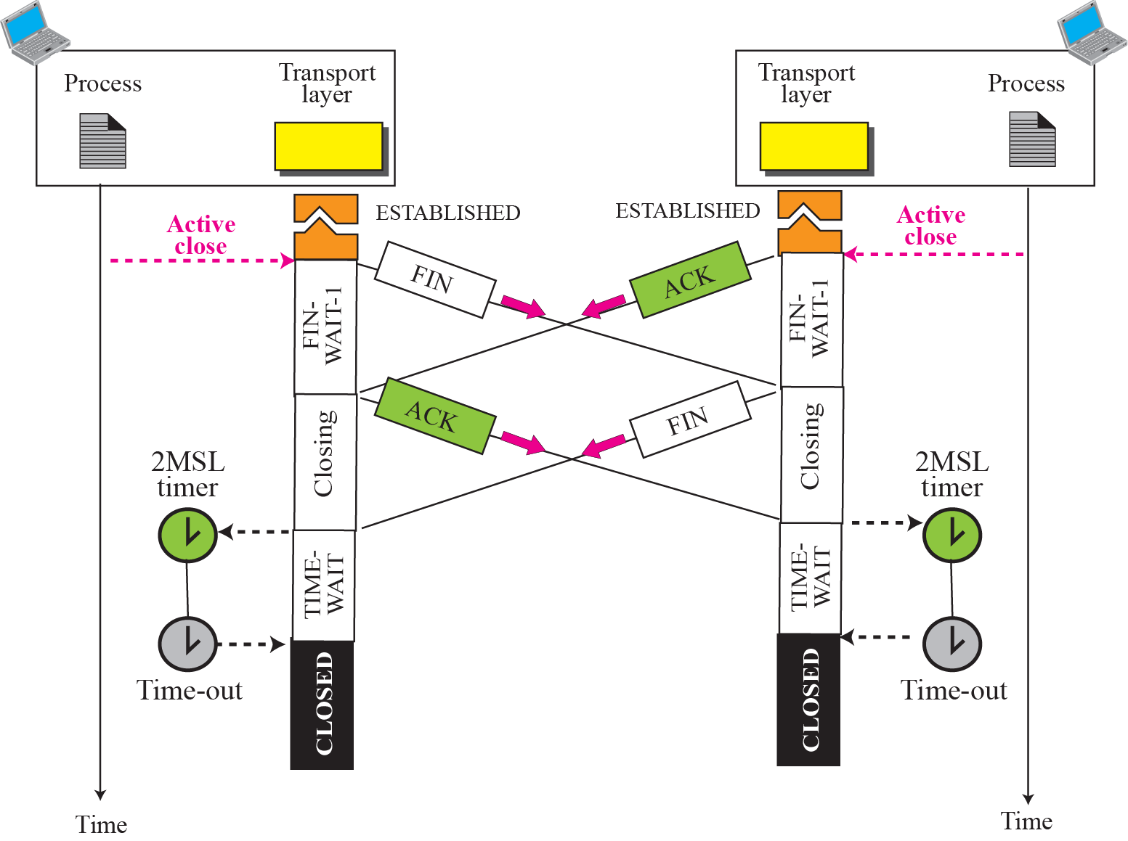
Simultaneous close
ex

Slide 15


WINDOWS IN TCP
Send window in TCP

Slide 16
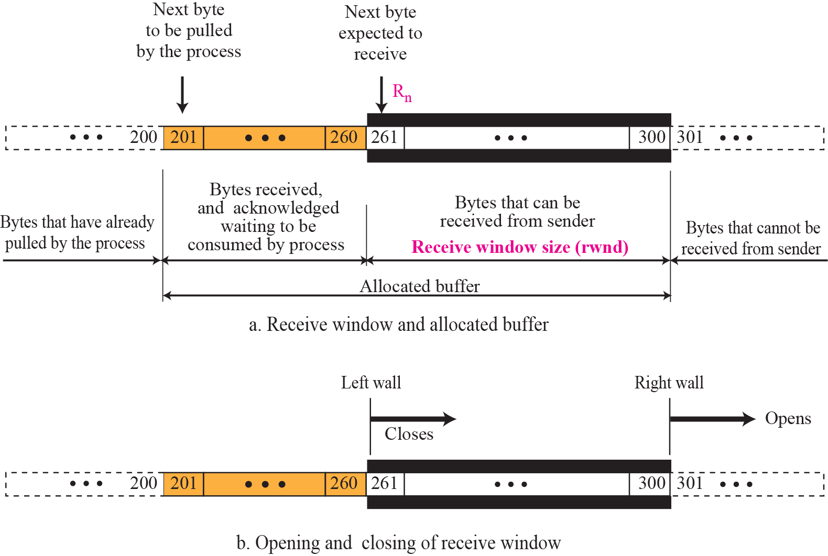
Receive window in TCP

Slide 17
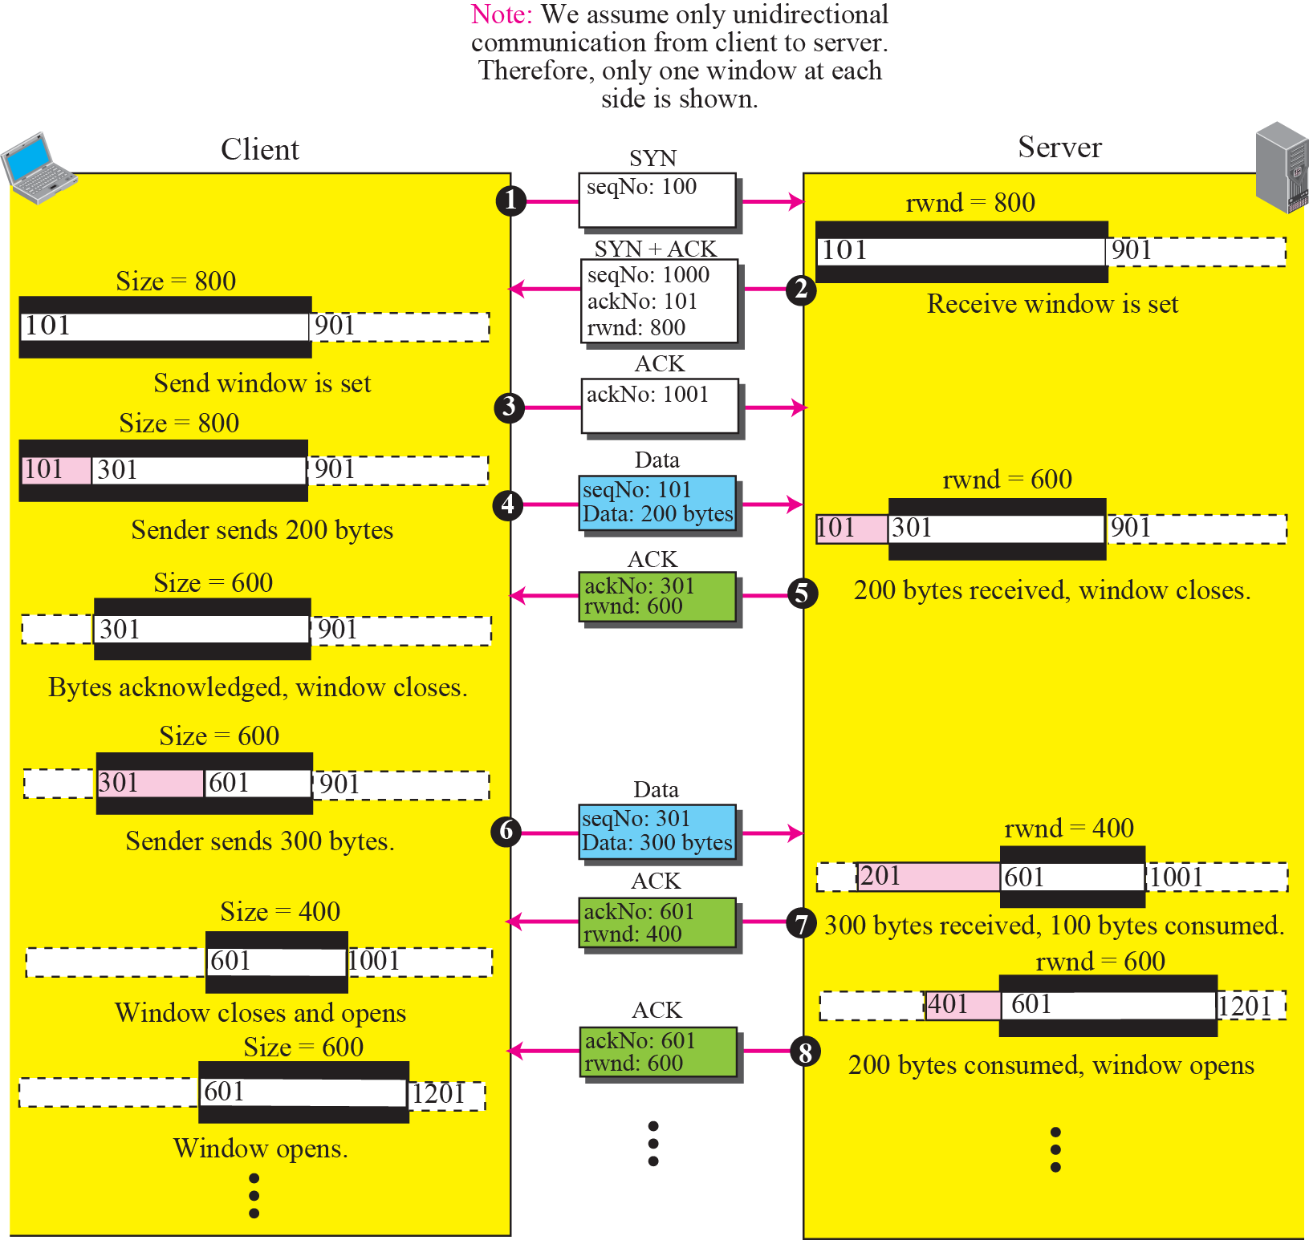
FLOW CONTROL
An example of flow control

Slide 18
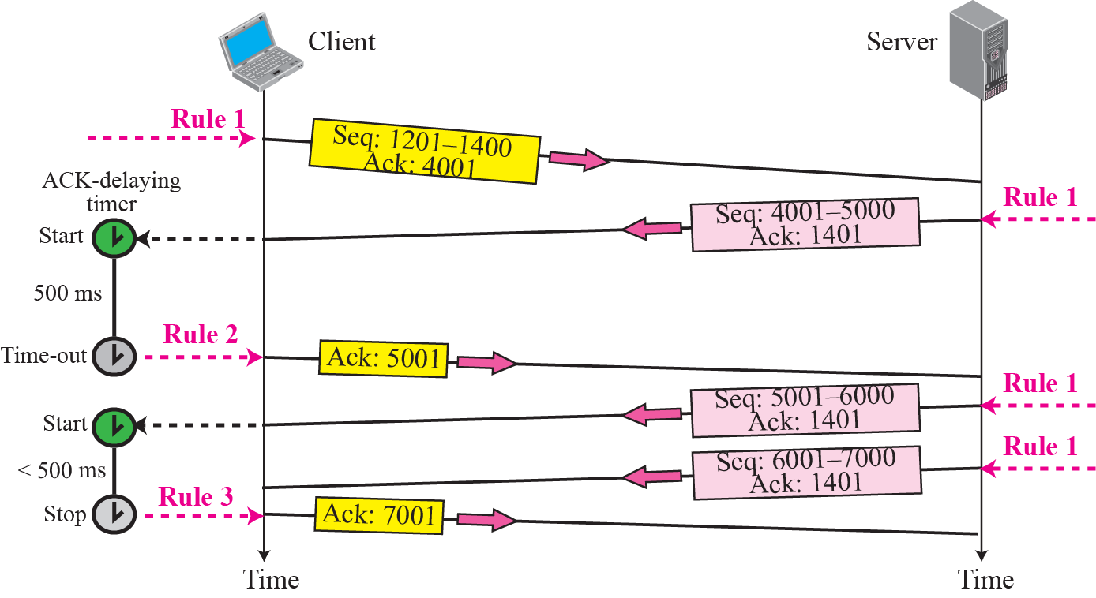
ERROR CONTROL
Normal operation

Slide 19
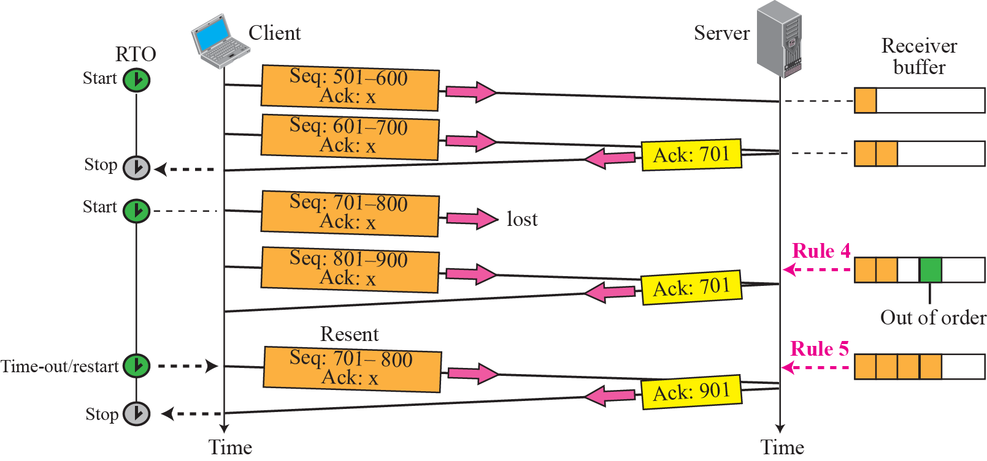
Lost segment

Slide 20
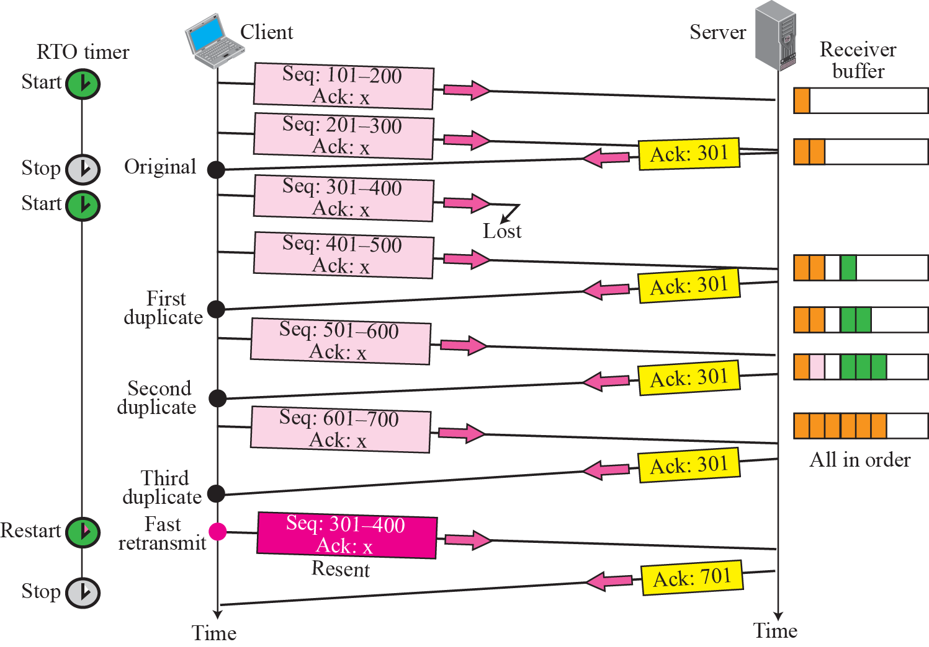





Fast retransmission

Slide 21
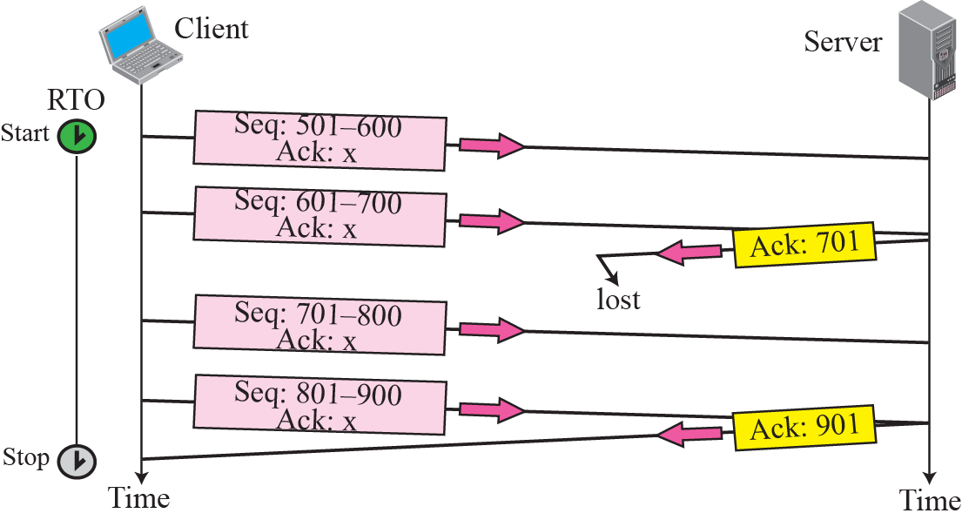
Lost acknowledgment

Slide 22
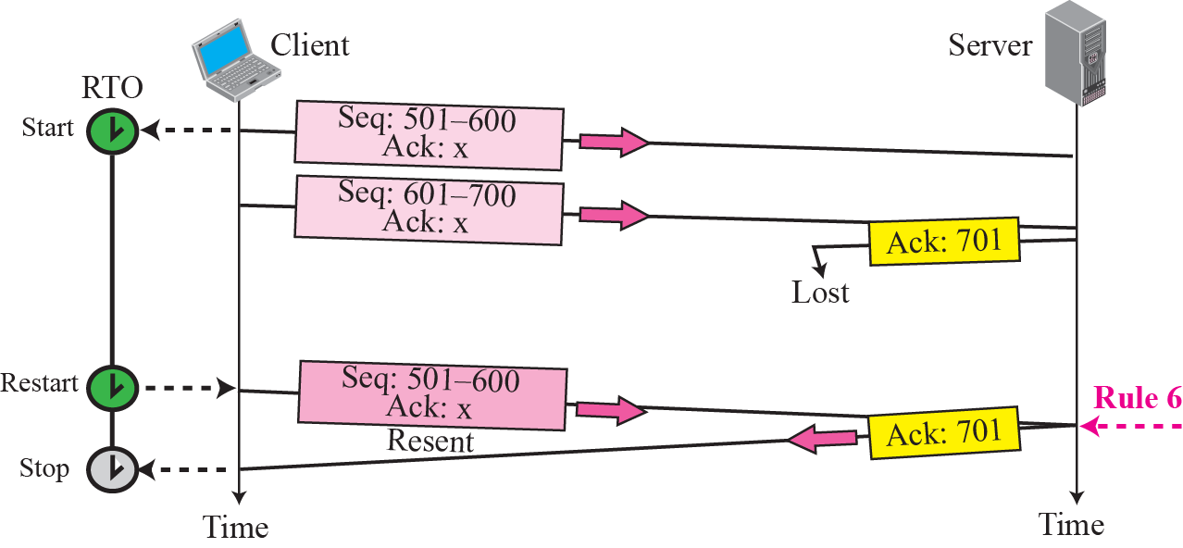
Lost acknowledgment corrected by resending a segment

Slide 23
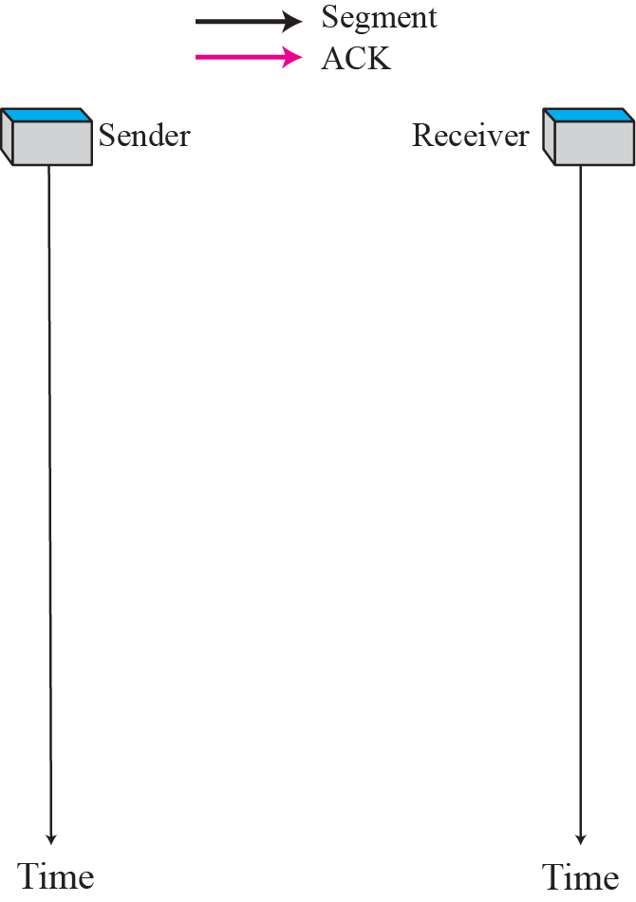
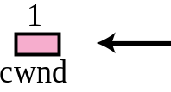
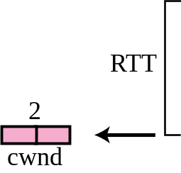
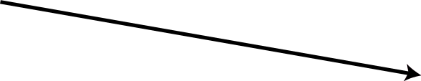

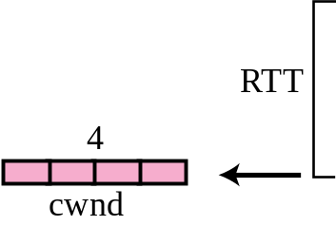
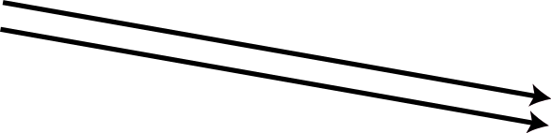
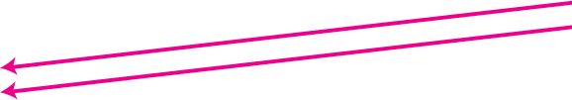

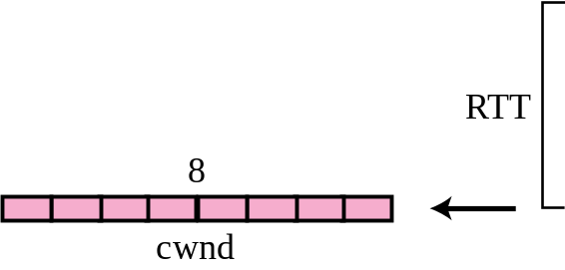

CONGESTION CONTROL
Slow start, exponential increase

Slide 24
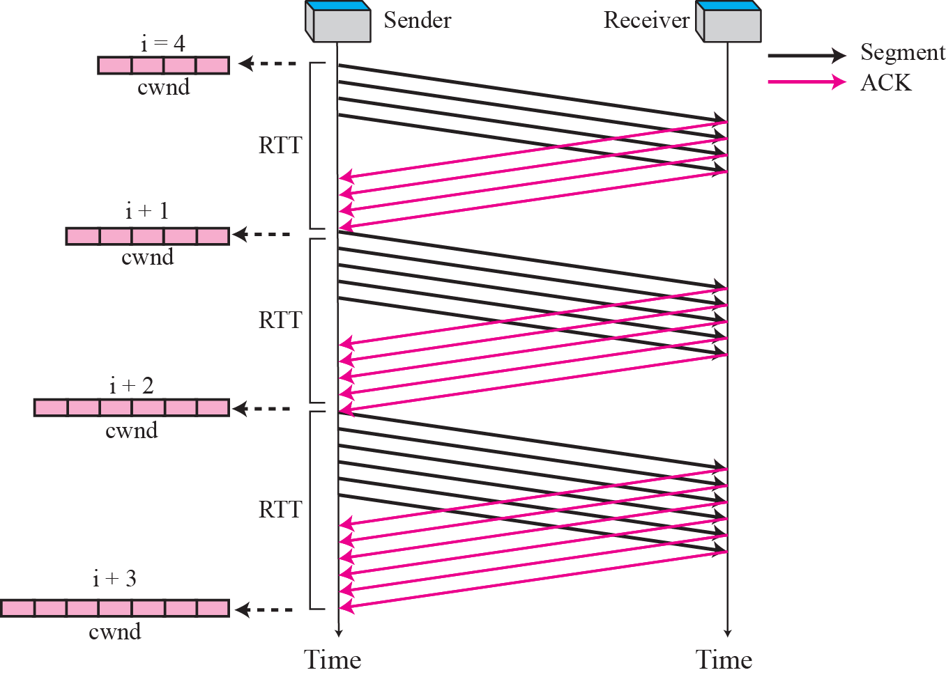
Congestion avoidance, additive increase

Slide 25
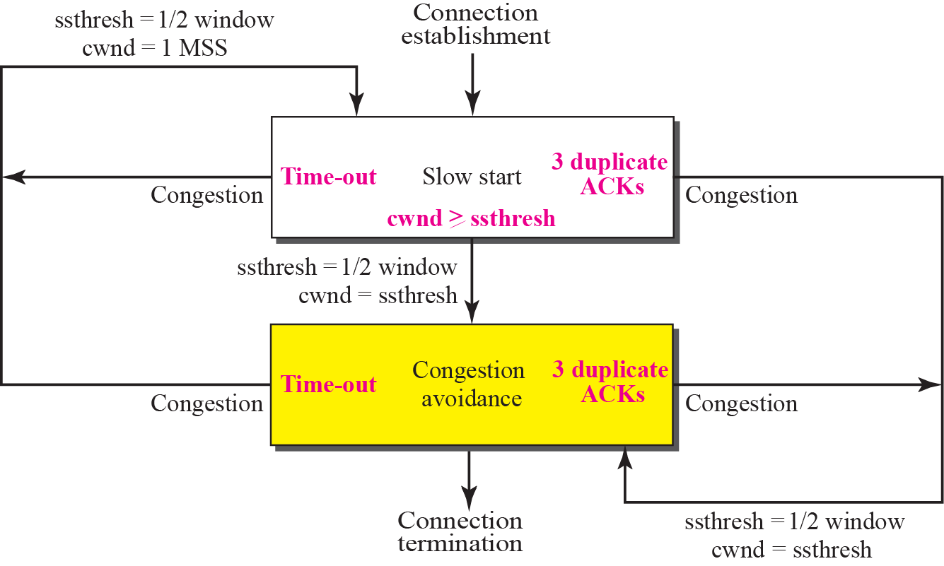
TCP Congestion policy summary

Slide 26
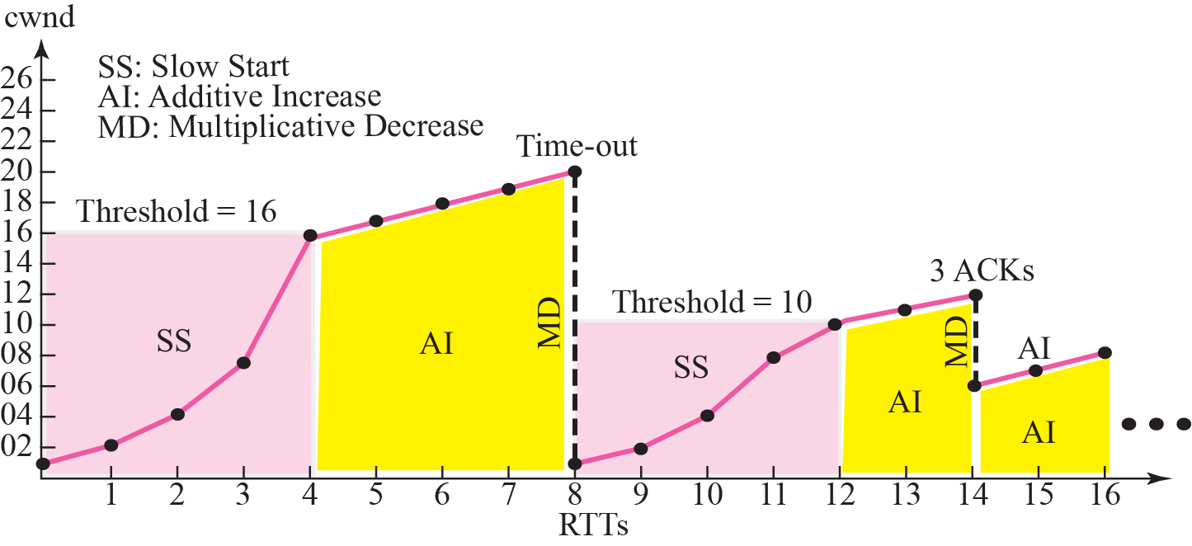
Congestion example

